Slide 1

Portfolio Theory Project
Notes:
It is using the background from https://dribbble.com/shots/1588545--Freebie-7-Low-Poly-Backgrounds-svg-png
Template modified by fppt.com

Slide 2

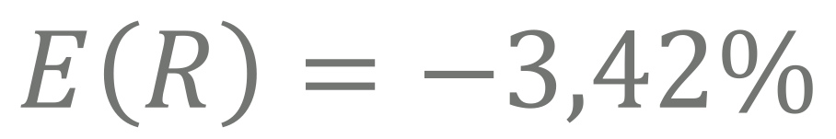

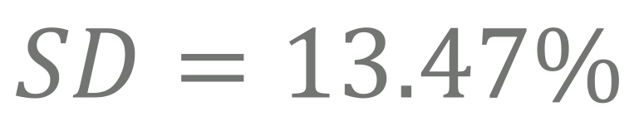
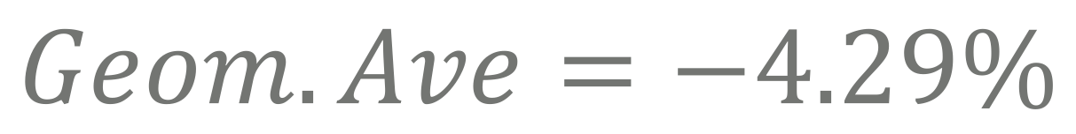

INDEX STATISTICS:
Based on weekly data from 23/03/2017 to 24/03/2018
$$E\left(R\right)=−3,42\%$$
$$Geom.Ave=−4.29\%$$
$$Terminal Value=0.958$$
$$SD=13.47\%$$
$$Sr=−0.251$$

Slide 3
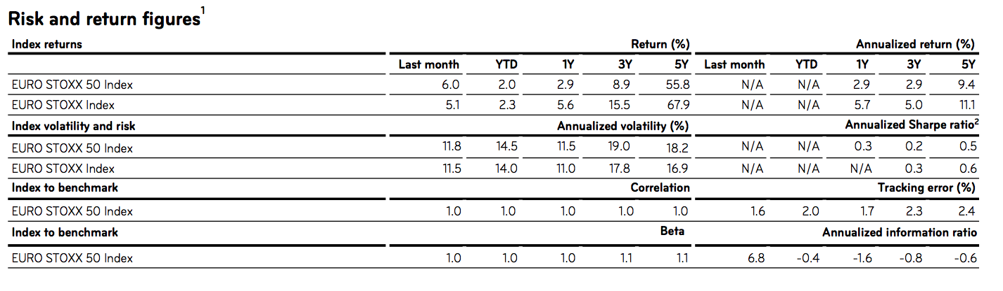
INDEX STATISTICS:
Comparison with EURO STOXX

Slide 4
BENCHMARK COMPOSTION:

Slide 5





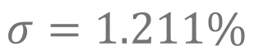


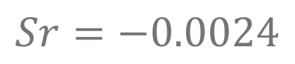
BENCHMARK INFORMATION:
Average sector composition
50k
followers
followers
CONSUMER DISCRETIONARY:
CONSUMER STAPLES:
ENERGY:
$$E\left(R\right)=0.422\%$$
$$E\left(R\right)=−0.007\%$$
$$E\left(R\right)=0.114\%$$
$$σ=2.922\%$$
$$σ=2.730\%$$
$$σ=1.211\%$$
$$Sr=0.1444$$
$$Sr=−0.0024$$
$$Sr=0.0940$$

Slide 6
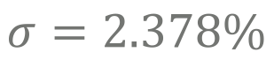

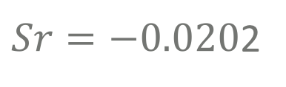



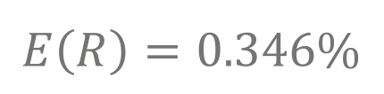

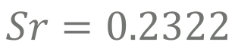
BENCHMARK’S INFORMATION:
Average sector composition
50k
followers
followers
FINANCIAL:
HEALTH CARE:
INDUSTRIALS:
$$E\left(R\right)=0.346\%$$
$$E\left(R\right)=−0.038\%$$
$$E\left(R\right)=0.552\%$$
$$σ=4.973\%$$
$$σ=1.866\%$$
$$σ=2.378\%$$
$$Sr=0.0769$$
$Sr=−0.020$2
$$Sr=0.2322$$

Slide 7
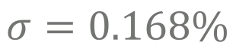

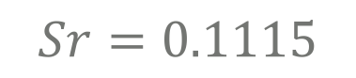



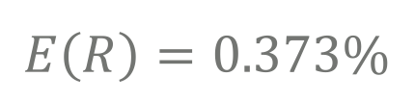

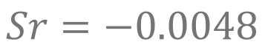
BENCHMARK’S INFORMATION:
Average sector composition
50k
followers
followers
INFORMATION TECHNOLOGY:
MATERIALS:
REAL ESTATE:
$$E\left(R\right)=0.373\%$$
$$E\left(R\right)=−0.107\%$$
$E\left(R\right)=$-0.001%
$$σ=1.236\%$$
$$σ=0.955\%$$
$$σ=0.168\%$$
$$Sr=0.3019$$
$$Sr=0.1115$$
$$Sr=−0.0048$$

Slide 8

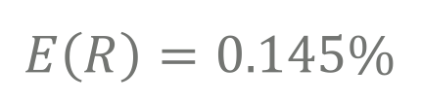

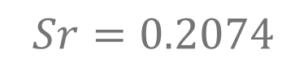


BENCHMARK’S INFORMATION:
Average sector composition
50k
followers
TELECOMUNICATION SERVICES:
HEALTH CARE:
$$E\left(R\right)=0.145\%$$
$$E\left(R\right)=0.204\%$$
$$σ=1.238\%$$
$$σ=0.986\%$$
$$Sr=0.1172$$
$$Sr=0.2074$$

Slide 9
SECTORS EXPECTED RETURNS:

Slide 10
SECTORS VOLATILITY:

Slide 11
A LITTLE HISTORY
Portfolio returns along weeks
SECOND DECISION
FINAL DECISION
Returns: 1,66%
Returns: 0.88%
Sharpe ratio: 0.4273
Sharpe ratio: 0.8274
1990
23/03 - 30/03
30/03 – 06/04
06/04 – 13/04
13/04 – 20/04
FIRST DECISION
THIRD DECISION
Returns: 2.35%
Returns: 0.20%
Sharpe ratio: 0.1172
Sharpe ratio: 0.4273

Slide 12

FIRST DECISION:
Choice criterions:
1
P/B ratio and P/E:
We have selected all those securities which have a P/B ratio and P/E ratio lower than the P/B and P/E of the sector.
2
ROA and ROE
We have selected all those securities which have a ROA and ROE higher than the ROA and ROE (we considered only firms in which k > g) of the sector.
3
Beta:
We have given a higher weight in the portfolio to those security with a beta lower than 1.
4
Diversification:
We have tried to pick some security from each sector.

Slide 13
FIRST DECISION:
Choice criterions
Name: | Code: | P/B_Ratio: | P/B_Sector: | ROA: | ROA_Sector: | P/E_Ratio: | P/E_Ratio: | ROE: | ROE_Sector: | BETA:
Deutsche Post AG | DPW GY Equity | 4,0100 | 5,3800 | 7,4100 | 2,5100 | 17,6600 | 58,8400 | 26,4600 | 14,2700 | 0,9430
Fresenius SE & Co KGaA | FRE GY Equity | 2,9800 | 3,6400 | 6,0400 | 5,1000 | 22,5300 | 28,4200 | 13,8664 | 10,0900 | 0,9054
L'Oreal SA | OR FP Equity | 4,0658 | 4,9100 | 10,0928 | 6,8500 | 27,8000 | 66,4400 | 15,7500 | 14,3500 | 0,7709
Safran SA | SAF FP Equity | 3,9700 | 6,5400 | 8,6400 | 3,6100 | 13,9800 | 49,6300 | 32,6400 | 19,7000 | 1,0224
adidas AG | ADS GY Equity | 6,2502 | 2,6600 | 8,2000 | 6,5700 | 33,3900 | 21,4500 | 19,7300 | 11,4000 | 0,7399
BASF SE | BAS GY Equity | 2,6200 | 1,3000 | 6,8200 | 4,1700 | 17,3300 | 16,3000 | 15,9400 | 11,4800 | 1,0652
Industria de Diseno Textil SA | ITX SQ Equity | 8,3100 | 3,8700 | 17,5300 | 5,6600 | 29,4900 | 35,6800 | 29,1600 | 11,8100 | 0,8011
Siemens AG | SIE GY Equity | 2,3000 | 1,9000 | 4,7200 | 4,7700 | 16,7100 | 19,2500 | 15,3195 | 9,9600 | 1,1020
Unilever NV | UNA NA Equity | 8,7200 | 4,6600 | 10,1200 | 6,6000 | 22,3400 | 75,5900 | 36,5200 | 12,4000 | 0,9725
Vivendi SA | VIV FP Equity | 1,4200 | 0,6500 | 3,2166 | -4,8700 | 59,3300 | 42,9400 | 2,7100 | -0,7700 | 1,0298
Koninklijke Ahold Delhaize NV | AD NA Equity | 1,5097 | 4,6600 | 5,1806 | 3,6200 | 12,8621 | 38,0500 | 11,5563 | 10,2900 | 0,7634
Danone SA | BN FP Equity | 2,8648 | 3,2000 | 5,5613 | 8,1000 | 16,7963 | 20,9400 | 17,7689 | 15,1100 | 0,8652
AXA SA | CS FP Equity | 0,7637 | 1,6500 | 0,7044 | 0,8500 | 8,9417 | 31,6300 | 8,8358 | 4,7500 | 1,2214
Engie SA | ENGI FP Equity | 0,8800 | 2,0400 | 1,2600 | 5,0400 | 33,6000 | 18,4400 | 2,5589 | 28,0800 | 0,9468
E.ON SE | EOAN GY Equity | 5,4700 | 2,3000 | 1,0900 | 3,6400 | 2,3000 | 14,8500 | 124,3300 | 16,2500 | 1,0057
Unibail-Rodamco SE | UL NA Equity | 1,3418 | 1,9600 | 6,4800 | 3,2400 | 8,1000 | 32,3200 | 13,4106 | 6,9900 | 0,9260

Slide 14
FIRST DECISION:
Portfolio composition 1
adidas AG | AD NA Equity | Consumer, Non-cyclical | 15%
Vivendi SA | ADS GY Equity | Consumer, Cyclical | 12%
L'Oreal SA | BAS GY Equity | Basic Materials | 4%
Unilever NV | BN FP Equity | Consumer, Non-cyclical | 4%
AXA SA | CS FP Equity | Financial | 4%
Fresenius SE & Co KGaA | DPW GY Equity | Industrial | 3%
Deutsche Post AG | ENGI FP Equity | Utilities | 8%
Safran SA | EOAN GY Equity | Utilities | 4%
Siemens AG | FRE GY Equity | Consumer, Non-cyclical | 4%
BASF SE | ITX SQ Equity | Consumer, Cyclical | 8%
Unibail-Rodamco SE | OR FP Equity | Consumer, Non-cyclical | 15%
E.ON SE | SAF FP Equity | Industrial | 4%
Engie SA | SIE GY Equity | Industrial | 4%
Industria de Diseno Textil SA | UL NA Equity | Financial | 4%
Koninklijke Ahold Delhaize NV | UNA NA Equity | Consumer, Non-cyclical | 6%
Danone SA | VIV FP Equity | Communications | 4%

Slide 15
FIRST DECISION:
Portfolio composition 2:
Basic Materials | 4%
Communications | 4%
Consumer, Cyclical | 20%
Consumer, Non-cyclical | 43%
Financial | 8%
Industrial | 12%
Utilities | 12%

Slide 16
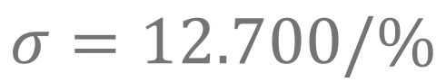
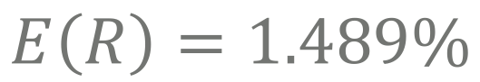
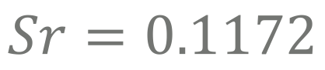
FIRST DECISION:
Portfolio Statistics:
$$E\left(R\right)=1.489\%$$
$$σ=12.700/\%$$
$$Sr=0.1172$$

Slide 17
FIRST DECISION:
Performance Attribution 1

Slide 18
FIRST DECISION:
Performance Attribution 2
Sector: | Allocation effect | Selection effect
Consumer Discretionary | 0,45% | 4,95%
Consumer Staples | 3,34% | 9,91%
Energy | -1,29% | 0,00%
Financials | 4,48% | 2,25%
Health Care | -0,30% | 0,71%
Industrials | 0,54% | 5,04%
Information Technology | -0,81% | 0,00%
Materials | -0,22% | 0,41%
Real Estate | 0,63% | 0,11%
Telecommunication Services | -0,65% | 0,00%
Utilities | 1,15% | 1,70%
TOT: | 7,32% | 25,10%

Slide 19
SECOND DECISION:
Choice criterions:
1
P/B ratio and P/E:
We have selected all those securities which have a P/B ratio and P/E ratio lower than the P/B and P/E of the sector.
2
ROA and ROE
We have selected all those securities which have a ROA and ROE higher than the ROA and ROE (we considered only firms in which k > g) of the sector.
3
Beta:
We have given a higher weight in the portfolio to those security with a beta lower than 1.
4
Diversification:
In order to benefit from the power of diversification, we have decided to add more securities.

Slide 20
SECOND DECISION:
Choice criterions
Name: | Code: | P/B_Ratio: | P/B_Sector: | ROA: | ROA_Sector: | P/E_Ratio: | P/E_Sector: | ROE: | ROE_Sector: | BETA:
Deutsche Post AG | DPW GY Equity | 4,0100 | 5,3800 | 7,4100 | 2,5100 | 17,6600 | 58,8400 | 26,4600 | 14,2700 | 0,9430
Fresenius SE & Co KGaA | FRE GY Equity | 2,9800 | 3,6400 | 6,0400 | 5,1000 | 22,5300 | 28,4200 | 13,8664 | 10,0900 | 0,9054
L'Oreal SA | OR FP Equity | 4,0658 | 4,9100 | 10,0928 | 6,8500 | 27,8000 | 66,4400 | 15,7500 | 14,3500 | 0,7709
Safran SA | SAF FP Equity | 3,9700 | 6,5400 | 8,6400 | 3,6100 | 13,9800 | 49,6300 | 32,6400 | 19,7000 | 1,0224
adidas AG | ADS GY Equity | 6,2502 | 2,6600 | 8,2000 | 6,5700 | 33,3900 | 21,4500 | 19,7300 | 11,4000 | 0,7399
BASF SE | BAS GY Equity | 2,6200 | 1,3000 | 6,8200 | 4,1700 | 17,3300 | 16,3000 | 15,9400 | 11,4800 | 1,0652
Industria de Diseno Textil SA | ITX SQ Equity | 8,3100 | 3,8700 | 17,5300 | 5,6600 | 29,4900 | 35,6800 | 29,1600 | 11,8100 | 0,8011
Siemens AG | SIE GY Equity | 2,3000 | 1,9000 | 4,7200 | 4,7700 | 16,7100 | 19,2500 | 15,3195 | 9,9600 | 1,1020
Unilever NV | UNA NA Equity | 8,7200 | 4,6600 | 10,1200 | 6,6000 | 22,3400 | 75,5900 | 36,5200 | 12,4000 | 0,9725
Vivendi SA | VIV FP Equity | 1,4200 | 0,6500 | 3,2166 | -4,8700 | 59,3300 | 42,9400 | 2,7100 | -0,7700 | 1,0298
Koninklijke Ahold Delhaize NV | AD NA Equity | 1,5097 | 4,6600 | 5,1806 | 3,6200 | 12,8621 | 38,0500 | 11,5563 | 10,2900 | 0,7634
Allianz SE | ALV GY Equity | 1,3500 | 2,0900 | 0,8900 | 1,3200 | 11,6500 | 29,7400 | 10,2582 | 6,5800 | 1,1211
Bayer AG | BAYN GY Equity | 2,9800 | 4,8000 | 6,5000 | 11,4000 | 23,8626 | 30,9400 | 16,3900 | 16,3300 | 1,0141
Bayerische Motoren Werke AG | BMW GY Equity | 1,1700 | 2,1000 | 4,1600 | 6,2400 | 7,6700 | 16,2500 | 16,2400 | 12,9600 | 1,1314
Danone SA | BN FP Equity | 2,8648 | 3,2000 | 5,5613 | 8,1000 | 16,7963 | 20,9400 | 17,7689 | 15,1100 | 0,8652
AXA SA | CS FP Equity | 0,7637 | 1,6500 | 0,7044 | 0,8500 | 8,9417 | 31,6300 | 8,8358 | 4,7500 | 1,2214
Daimler AG | DAI GY Equity | 1,2300 | 2,1000 | 4,3000 | 6,2400 | 7,4300 | 16,2500 | 17,2579 | 12,9600 | 1,0833
Engie SA | ENGI FP Equity | 0,8800 | 2,0400 | 1,2600 | 5,0400 | 33,6000 | 18,4400 | 2,5589 | 28,0800 | 0,9468
E.ON SE | EOAN GY Equity | 5,4700 | 2,3000 | 1,0900 | 3,6400 | 2,3000 | 14,8500 | 124,3300 | 16,2500 | 1,0057
Unibail-Rodamco SE | UL NA Equity | 1,3418 | 1,9600 | 6,4800 | 3,2400 | 8,1000 | 32,3200 | 13,4106 | 6,9900 | 0,9260

Slide 21
SECOND DECISION:
Portfolio composition 1
Adidas AG | ADS GY Equity | Consumer, Cyclical | 8%
Koninklijke Ahold Delhaize NV | AD NA Equity | Consumer, Non-cyclical | 2%
Allianz SE | ALV GY Equity | Financials | 8%
BASF SE | BAS GY Equity | Basic Materials | 2%
Bayer AG | BAYN GY Equity | Health Care | 2%
Bayerische Motoren Werke AG | BMW GY Equity | Consumer Discretionary | 8%
Danone SA | BN FP Equity | Consumer, Non-cyclical | 8%
AXA SA | CS FP Equity | Financial | 2%
Daimler AG | DAI GY Equity | Consumer Discretionary | 2%
Deutsche Post AG | DPW GY Equity | Industrial | 8%
Engie SA | ENGI FP Equity | Utilities | 8%
E.ON SE | EOAN GY Equity | Utilities | 8%
Fresenius SE & Co KGaA | FRE GY Equity | Consumer, Non-cyclical | 2%
Industria de Diseno Textil SA | ITX SQ Equity | Consumer, Cyclical | 2%
L'Oreal SA | OR FP Equity | Consumer, Non-cyclical | 8%
Safran SA | SAF FP Equity | Industrial | 8%
Siemens AG | SIE GY Equity | Industrial | 2%
Unibail-Rodamco SE | UL NA Equity | Financial | 2%
Unilever NV | UNA NA Equity | Consumer, Non-cyclical | 2%
Vivendi SA | VIV FP Equity | Communications | 8%

Slide 22
SECOND DECISION:
Portfolio composition 2:
Basic Materials | 2%
Communications | 8%
Consumer Discretionary | 10%
Consumer, Cyclical | 10%
Consumer, Non-cyclical | 22%
Financial | 12%
Health Care | 2%
Industrial | 18%
Utilities | 16%

Slide 23
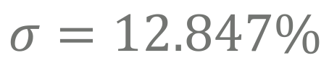
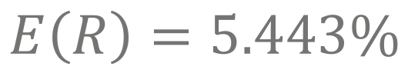
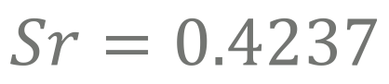
SECOND DECISION:
Portfolio Statistics:
$$E\left(R\right)=5.443\%$$
$$σ=12.847\%$$
$$Sr=0.4237$$

Slide 24
SECOND DECISION:
Performance Attribution 1

Slide 25
SECOND DECISION:
Performance Attribution 2
Sector | Allocation effect | Selection effect
Consumer Discretionary | 0,89% | -4,44%
Consumer Staples | 0,25% | -1,88%
Energy | 0,65% | 0,00%
Financials | -0,26% | -1,16%
Health Care | 0,15% | -0,16%
Industrials | 0,11% | -1,86%
Information Technology | 0,97% | 0,00%
Materials | 0,28% | -0,02%
Real Estate | -0,16% | 0,05%
Telecommunication Services | 0,25% | 0,00%
Utilities | -0,15% | -1,15%
TOT: | 2,98% | -10,61%

Slide 26

THIRD DECISION:
Choice criterions:

Slide 27
THIRD DECISION:
Performance Attribution 1

Slide 28
THIRD DECISION:
Performance Attribution 2
Sectors: | Allocation effect | Selection effect
Consumer Discretionary | 0,44% | -2,99%
Consumer Staples | 0,04% | -2,74%
Energy | -0,14% | 0,00%
Financials | -0,09% | -0,36%
Health Care | -0,03% | -0,06%
Industrials | -0,09% | -0,43%
Information Technology | 0,39% | 0,00%
Materials | 0,10% | -0,07%
Real Estate | -0,06% | -0,04%
Telecommunication Services | 0,15% | 0,00%
Utilities | -0,15% | -1,07%
TOT:: | 0,57% | -7,75%

Slide 29
LAST DECISION:
Choice criterions:
1
Passive strategy:
It has less cost in terms of time, it is a ‘free rider’ strategy and data has shown that portfolios made with this strategy have achieved better results in the last number of years.
2
Maximization of Sharpe Ratio
Following the Markowitz’s criteria we are interested in maximize the slope of the CAL, which is the Sharpe Ratio.
3
Minimize Standard Deviation:
Another constrain is that portfolio’s SD must be equal or less than the one of the Benchmark
4
Diversification:
Thanks to high number of securities included in our portfolio we can benefit of diversification. We decide that max. weight for each security is 7.00% and the minimum 0.05%.

Slide 30
LAST DECISION:
Portfolio composition 1
Instrument Name | Ticker | Sector | Weight
Anheuser-Busch InBev SA/NV | ABI BB Equity | Consumer Staples | 0,50%
Koninklijke Ahold Delhaize NV | AD NA Equity | Consumer Staples | 7,00%
adidas AG | ADS GY Equity | Consumer Discretionary | 7,00%
Air Liquide SA | AI FP Equity | Materials | 0,50%
Airbus SE | AIR FP Equity | Industrials | 7,00%
Allianz SE | ALV GY Equity | Financials | 0,50%
ASML Holding NV | ASML NA Equity | Information Technology | 7,00%
BASF SE | BAS GY Equity | Materials | 0,50%
Bayer AG | BAYN GY Equity | Health Care | 0,50%
Banco Bilbao Vizcaya Argentaria SA | BBVA SQ Equity | Financials | 0,50%
Bayerische Motoren Werke AG | BMW GY Equity | Consumer Discretionary | 0,50%
Danone SA | BN FP Equity | Consumer Staples | 0,50%
BNP Paribas SA | BNP FP Equity | Financials | 0,50%
CRH PLC | CRH ID Equity | Materials | 0,50%
AXA SA | CS FP Equity | Financials | 0,50%
Daimler AG | DAI GY Equity | Consumer Discretionary | 0,50%
Deutsche Bank AG | DBK GY Equity | Financials | 0,50%
Vinci SA | DG FP Equity | Industrials | 0,50%
Deutsche Post AG | DPW GY Equity | Industrials | 7,00%
Deutsche Telekom AG | DTE GY Equity | Telecommunication Services | 0,50%
Essilor International SA | EI FP Equity | Health Care | 0,50%
Enel SpA | ENEL IM Equity | Utilities | 0,50%
Engie SA | ENGI FP Equity | Utilities | 0,50%
Eni SpA | ENI IM Equity | Energy | 0,50%
E.ON SE | EOAN GY Equity | Utilities | 7,00%
Instrument Name | Ticker | Sector | Weight
TOTAL SA | FP FP Equity | Energy | 0,50%
Fresenius SE & Co KGaA | FRE GY Equity | Health Care | 0,50%
Societe Generale SA | GLE FP Equity | Financials | 0,50%
Iberdrola SA | IBE SQ Equity | Utilities | 0,50%
ING Groep NV | INGA NA Equity | Financials | 0,50%
Intesa Sanpaolo SpA | ISP IM Equity | Financials | 7,00%
Industria de Diseno Textil SA | ITX SQ Equity | Consumer Discretionary | 0,50%
LVMH Moet Hennessy Louis Vuitton SE | MC FP Equity | Consumer Discretionary | 7,00%
Munich Re | MUV2 GY Equity | Financials | 5,97%
Nokia OYJ | NOKIA FH Equity | Information Technology | 0,70%
L'Oreal SA | OR FP Equity | Consumer Staples | 0,50%
Orange SA | ORA FP Equity | Telecommunication Services | 0,50%
Koninklijke Philips NV | PHIA NA Equity | Industrials | 0,50%
Safran SA | SAF FP Equity | Industrials | 7,00%
Sanofi | SAN FP Equity | Health Care | 0,50%
Banco Santander SA | SAN SQ Equity | Financials | 0,50%
SAP SE | SAP GY Equity | Information Technology | 0,50%
Cie de Saint-Gobain | SGO FP Equity | Industrials | 0,50%
Siemens AG | SIE GY Equity | Industrials | 0,50%
Schneider Electric SE | SU FP Equity | Industrials | 0,50%
Telefonica SA | TEF SQ Equity | Telecommunication Services | 0,50%
Unibail-Rodamco SE | UL NA Equity | Real Estate | 0,50%
Unilever NV | UNA NA Equity | Consumer Staples | 0,50%
Vivendi SA | VIV FP Equity | Consumer Discretionary | 7,00%
Volkswagen AG | VOW3 GY Equity | Consumer Discretionary | 4,83%

Slide 31
LAST DECISION:
Portfolio composition 2:
Consumer Discretionary | 27%
Consumer Staples | 9%
Energy | 1%
Financials | 17%
Health Care | 2%
Industrials | 24%
Information Technology | 8%
Materials | 2%
Real Estate | 1%
Telecommunication Services | 2%
Utilities | 9%

Slide 32
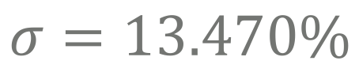
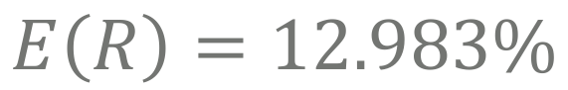
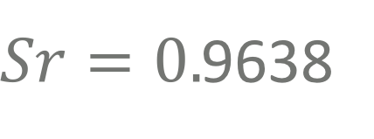
LAST DECISION:
Portfolio Statistics:
$$E\left(R\right)=12.983\%$$
$$σ=13.470\%$$
$Sr=0.$9638

Slide 33
LAST DECISION:
Performance Attribution 1

Slide 34
LAST DECISION:
Performance Attribution 2
Sectors: | Allocation Effect | Selection Effect
Consumer Discretionary | 0,98% | -5,55%
Consumer Staples | 0,95% | 1,21%
Energy | 0,13% | 0,04%
Financials | -0,16% | 0,95%
Health Care | -0,05% | -0,09%
Industrials | -0,04% | 4,35%
Information Technology | 0,01% | -0,53%
Materials | 0,23% | 0,18%
Real Estate | 0,01% | 0,00%
Telecommunication Services | 0,03% | 0,03%
Utilities | -0,06% | -0,22%
TOT.: | 2,04% | 0,39%

Slide 35
WHOLE PERIOD PERFORMANCE:
Performance Attribution 1

Slide 36
WHOLE PERIOD PERFORMANCE:
Performance Attribution 2
Attribution Effects
Allocation effect | Selection Effect
3,29% | -8,93%
5,69% | 8,44%
-0,87% | 0,04%
5,12% | 2,11%
-0,28% | 0,55%
0,68% | 8,53%
0,63% | -0,60%
0,45% | 0,64%
0,54% | 0,16%
-0,30% | 0,01%
1,05% | -0,75%
15,98% | 10,19%

Slide 37


PERFORMANCE MEASUREMENTS:
Steps:
Returns analysis:
We can compare the return of each portfolio and of the benchmark, in order to have a primary idea to understand which portfolio would be the best.
Performance indicators:
We can use some of the many performance indicators, which have been developed during the years. For instance, Sharpe Ratio, Information ratio and so on.

Slide 38
RETURNS ANALYSIS:
Plotting returns:

Slide 39
RETURNS ANALYSIS:
Portfolio simulation:

Slide 40
PERFORMANCE INDICATORS:
Plotting returns:
 | Portfolio A | Portfolio B | Portfolio C | Benchmark M
Average Return (Arithmetic) | 1,489% | 5,443% | 12,983% | -3,42%
Average Return (Geometric) | 0,679% | 4,719% | 12,817% | -4,241%
Standard Deviation | 12,824% | 12,973% | 13,601% | 13,598%
Lower Partial Standard Deviation | 9,18% | 9,38% | 8,97% | 10,82%
Sharpe Ratio | 0,12 | 0,42 | 0,95 | -0,25
M² | 5,00% | 9,12% | 16,40%
Alpha | 0,00085 | 0,00164 | 0,00313
Beta | 0,86188 | 0,89952 | 0,96622
Treynor | 0,02 | 0,06 | 0,13
Tracking Error | 5,26% | 4,36% | 3,55%
Information Ratio | 0,0162 | 0,0375 | 0,0882
R-SQR | 83,525% | 88,902% | 93,311%

Slide 41
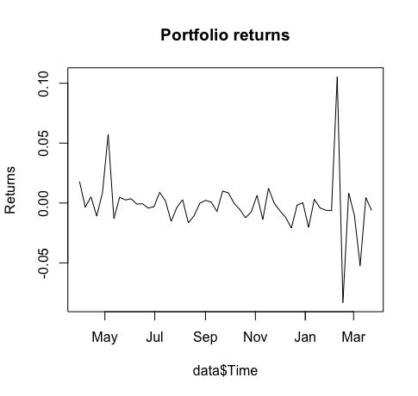
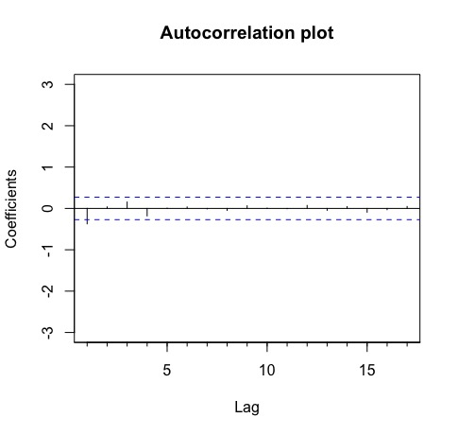
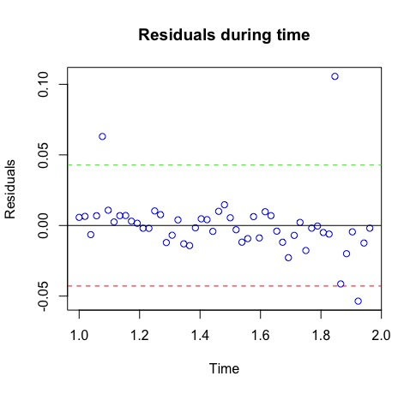
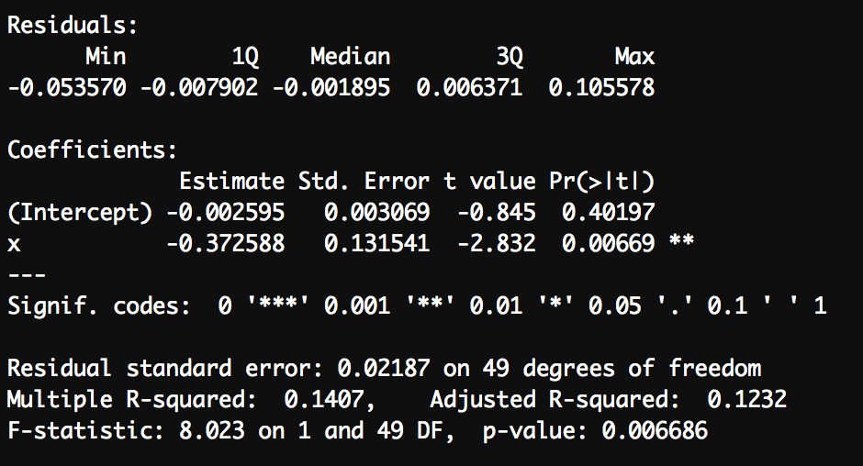
THE PAST CANNOT REPRESENT THE FUTURE:

